Slide 1
DSD - ASVS
Google Big query

Slide 2
Agenda
Problem Statement
BigQuery
Role of Distributed Systems in Big Query
Demonstation
Q/A

Slide 3
Problem Statement
HOME CREDIT DEFAULT ANALYSIS USING GOOGLE BIG QUERY

Slide 4
BIGQUERY

Slide 5
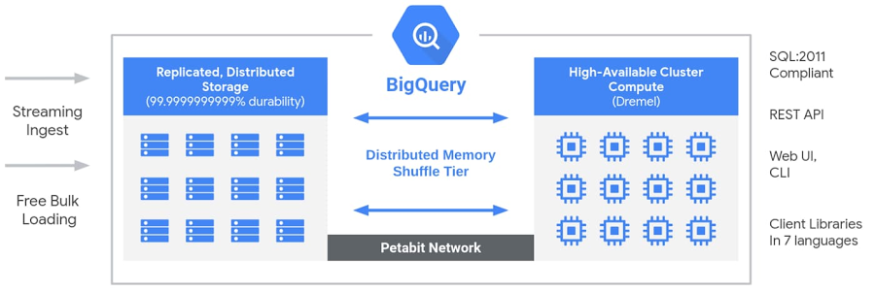
Architecture of BigQuery

Slide 6

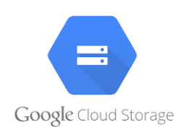


Overall Architecture – Google Cloud Platform
Kaggle Data Repository
Google Cloud Storage [Data Storage]
Google Data Studio
(Data Visualization)
Google Big Query
(Data Processing)

Slide 7
Observations and Findings
We have chosen Home Credit Default Risk dataset from Kaggle which contains 2.68 GB of Data
https://www.kaggle.com/c/home-credit-default-risk/data
GCP offers free 300$ credit for 90 days

Slide 8
Implementations
BigQuery basically being an end point query engine, we’ll be processing heavy memory and process intense queries.
Queries will be involving window functions on large data sets, multiple simple joins and complex joins including cross join and utilizations of Group by clauses.
Comparisons will be performed on Distributed system cloud service (GCP), postgresql and Oracle single system architecture.

Slide 9
Questions
What exactly we need to implement in GCP using distributed systems.

